Slide 1
An exploration of the cigarette data set

Slide 2
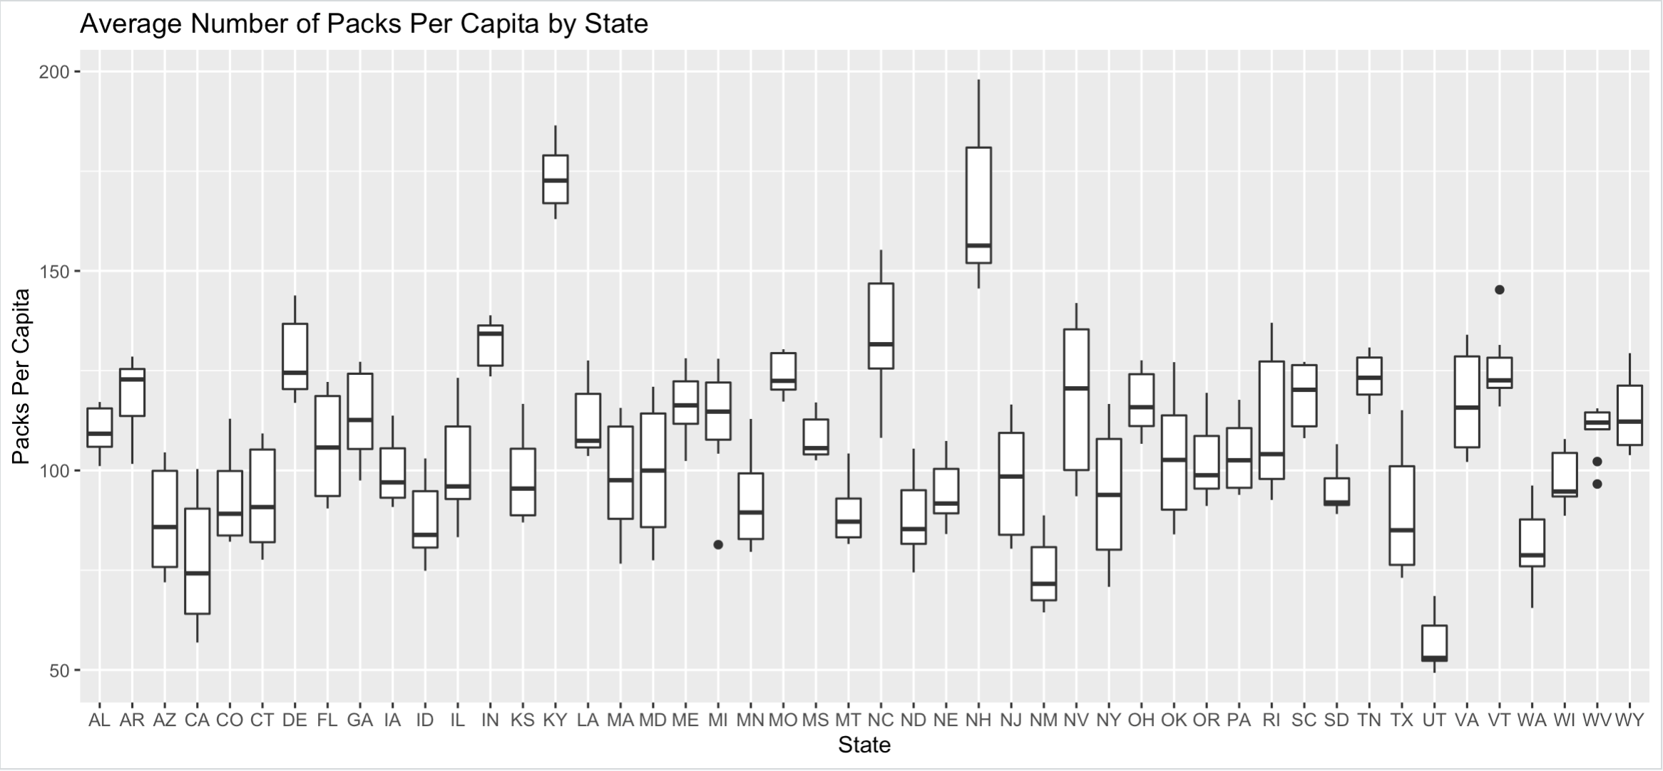
Box plot of the average number of packs per capita by state:
Cig.boxplot <- ggplot(Cigarette,aes(x = state, y = packpc)) + geom_boxplot() +
xlab("State") + ylab("Packs Per Capita") +
ggtitle("Average Number of Packs Per Capita by State")

Slide 3
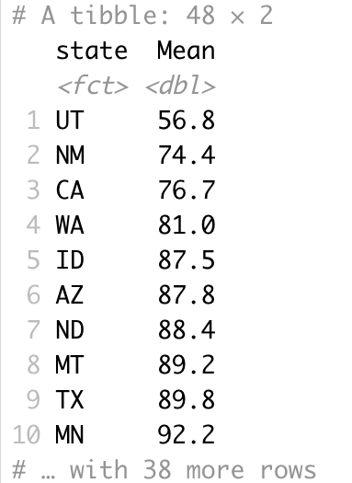
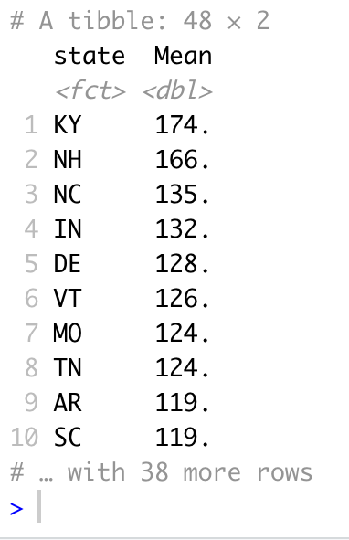
Review of the average number of packs per capita by state
The previous box plot had too many variables to sort through, so the information is organized to show the mean average number of packs per capita by state:
< Lowest number of packs
Highest number of packs >
Looking at the tibble on the left, the lowest number of packs per capita were in Utah. While the tibble on the right shows the highest number of packs per capita were in Kentucky.
Cig.boxplotL <- Cigarette %>% group_by(state) %>% summarise(Mean = mean(packpc)) %>% arrange(Mean)
Cig.boxplotH <- Cigarette %>% group_by(state) %>% summarise(Mean = mean(packpc)) %>% arrange(desc(Mean))

Slide 4
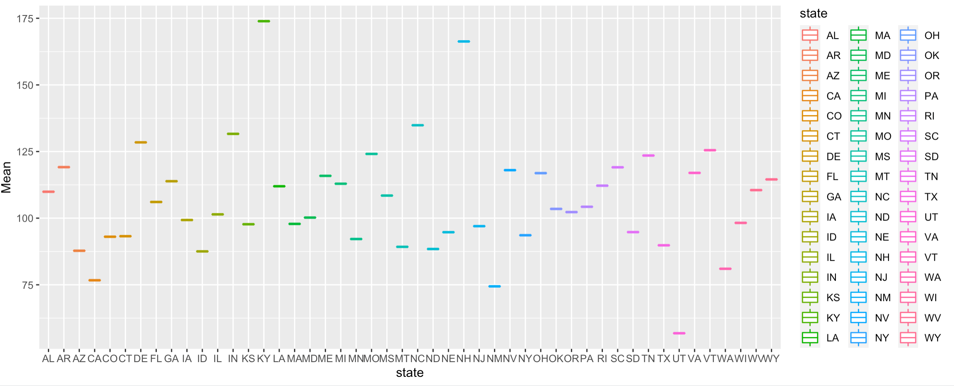

Box plot of the Mean of packs per capita by state:
ggplot(Cig.boxplotL, aes(x = state, y = Mean, color = state)) + geom_boxplot()

Slide 5
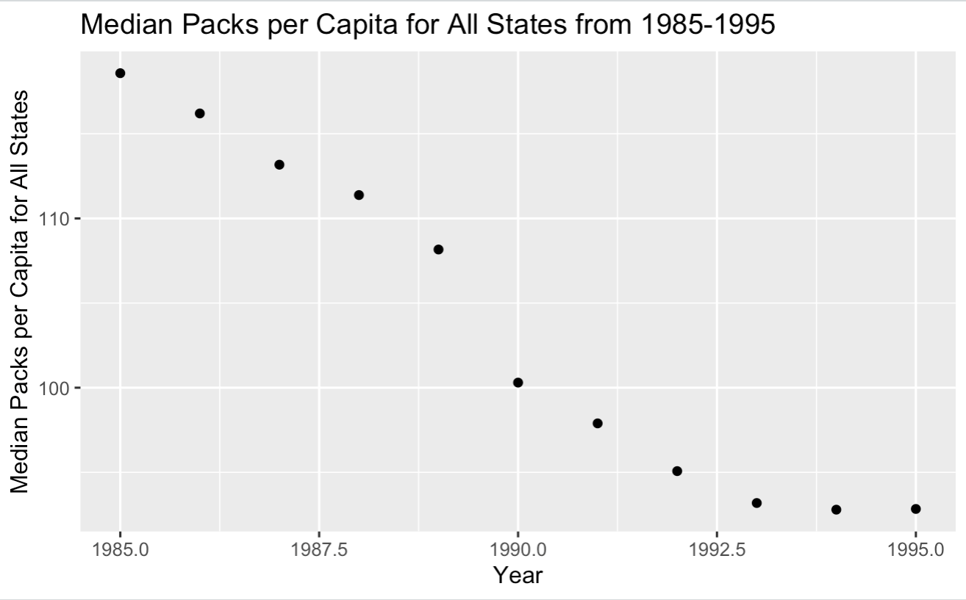
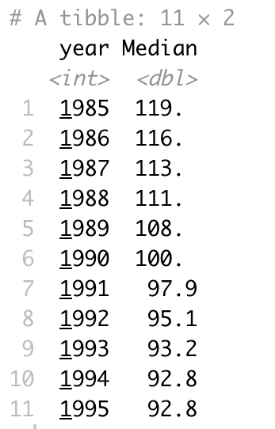
Median over all the states of the number of packs per capita for each year
From 1985-1995 there is a steady decline of packs per capita each year. Note, starting in 1994, the packs per capita have about leveled off and continue with the same rate into 1995.
CigMedian <- Cigarette %>% group_by(year) %>% summarise(Median = median(packpc))
CigMedYear <- ggplot(CigMedian, aes(x = year, y = Median)) + geom_point() +
xlab("Year") +
ylab("Median Packs per Capita for All States") +
ggtitle("Median Packs per Capita for All States from 1985-1995")

Slide 6
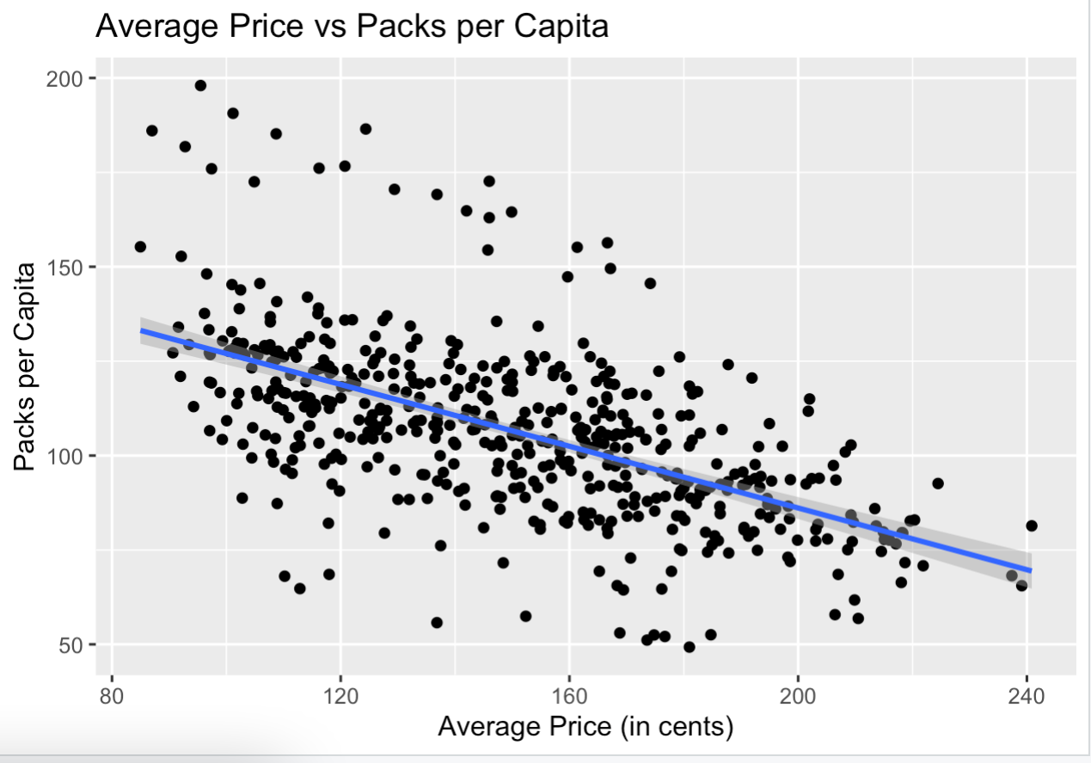
Scatter plot of price per pack vs. number of packs per capita
The average price and the per capita are negatively correlated; this is expected as one would assume that as the price increases over the years, the packs bought would decrease.
cor.test(Cigarette$avgprs, Cigarette$packpc, method = "pearson", use = "complete.obs")
CigScatter <- ggplot(Cigarette, aes(x = avgprs, y = packpc)) + geom_point() +
geom_smooth(method = lm) +
xlab("Average Price (in cents)") + ylab("Packs per Capita") +
ggtitle("Average Price vs Packs per Capita")

Slide 7
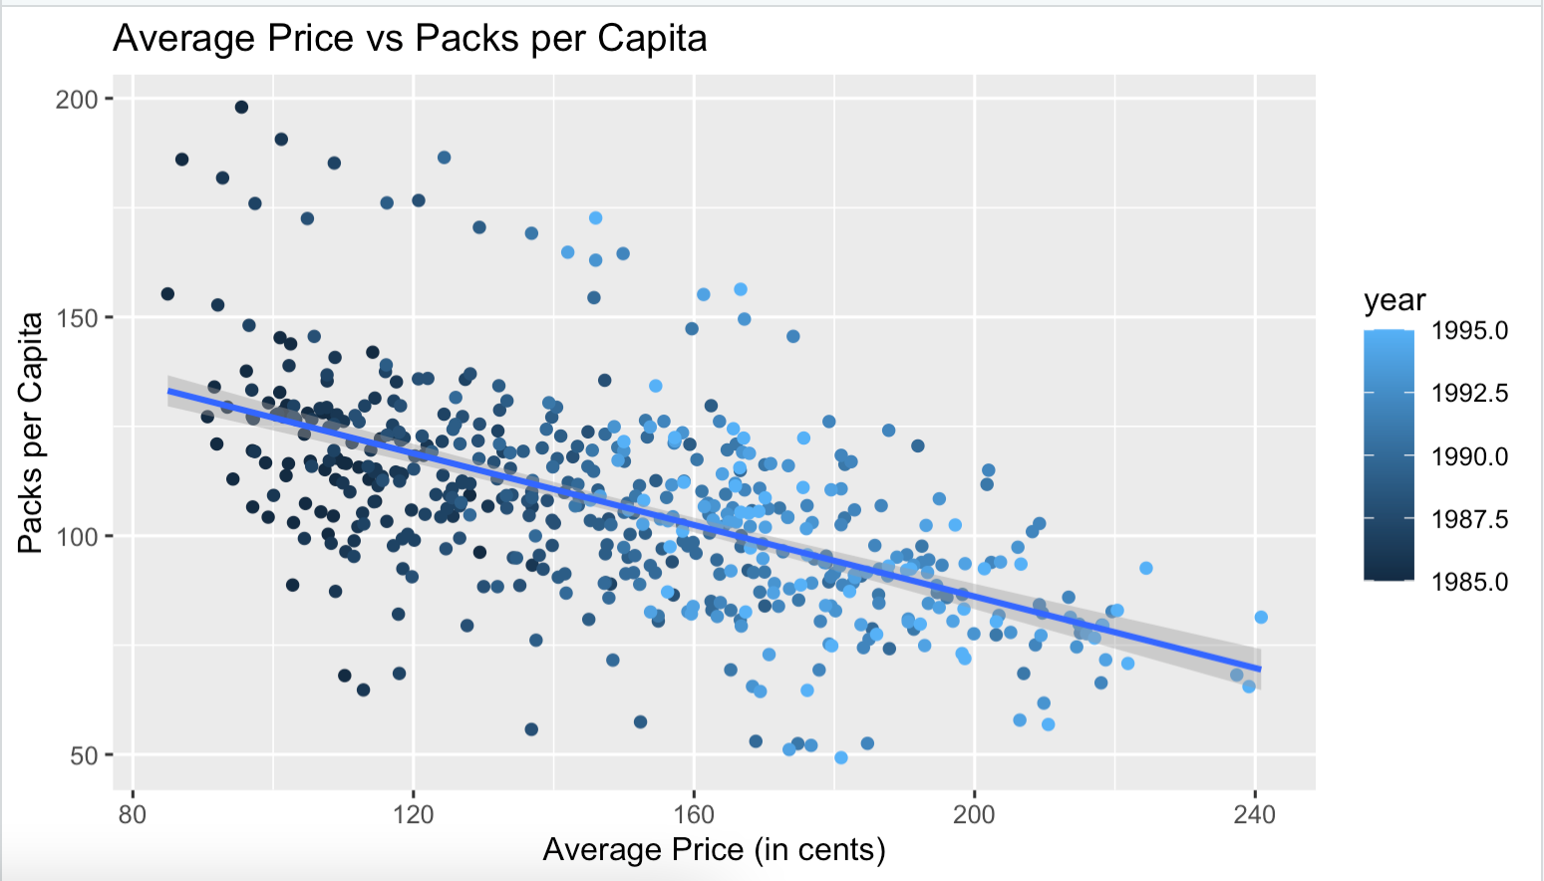
Scatter plot: emphasising year
The relationship between the two variables do change over time. Starting in 1985, when Cigarettes were less expensive, there were more packs per capita. Whereas later in the data set the average price has increased and the packs per capita has decreased.
CigScatterYear <- ggplot(Cigarette, aes(x = avgprs, y = packpc, color = year)) + geom_point() +
geom_smooth(method = lm) +
xlab("Average Price (in cents)") + ylab("Packs per Capita") +
ggtitle("Average Price vs Packs per Capita")

Slide 8
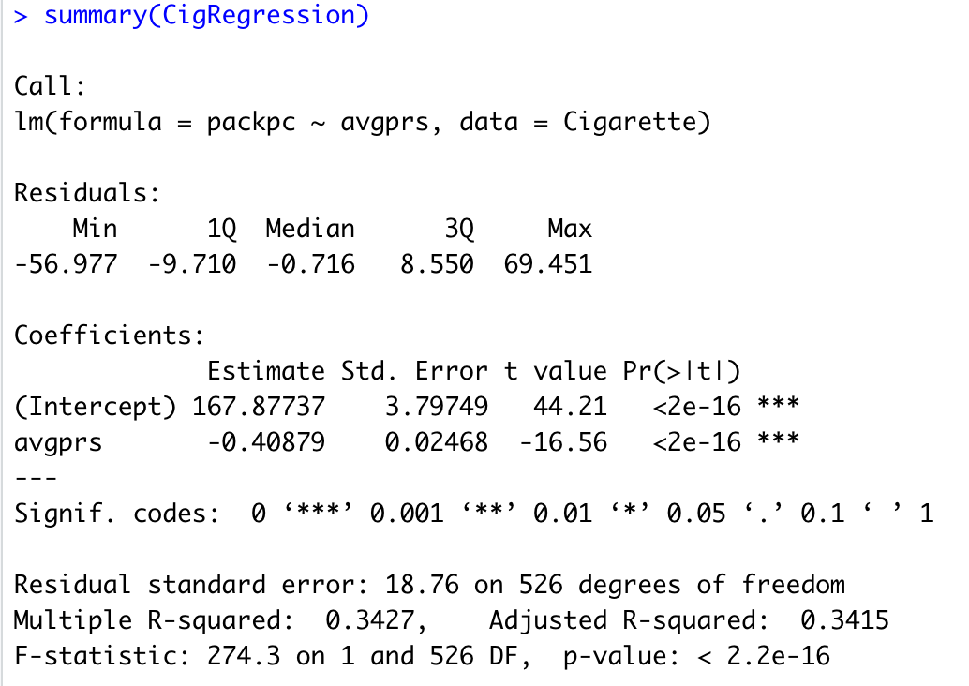
Linear regression of packs per capita ~ average price
34% of the variability
Packs per capita are going to decrease by -0.41 for every average one unit price increase.
Average price per pack accounts for 34% of everything that influences the packs per capita.
The p-value is <0.05 so the overall model is significant. Price per pack is a significant predictor of the packs per capita. The higher the price is, the lower the number of packs of cigarettes are sold.
CigRegression <- lm(packpc ~ avgprs, Cigarette)
summary(CigRegression)

Slide 9
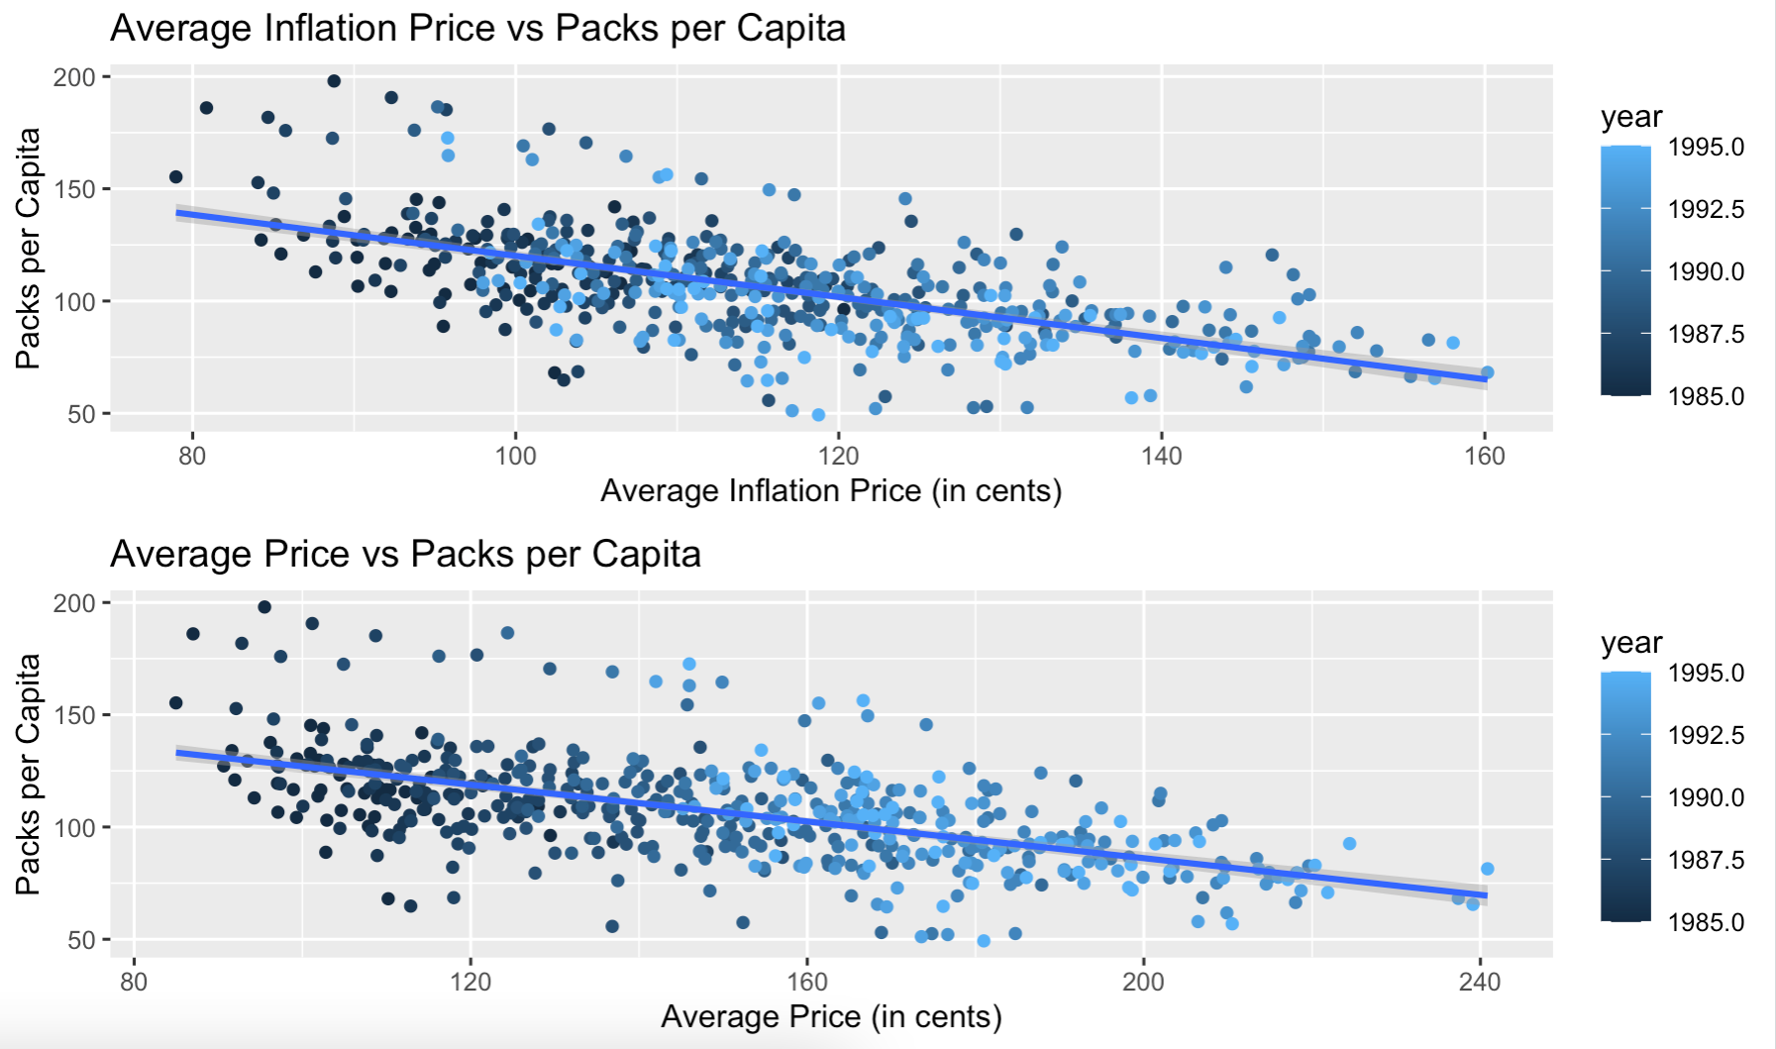
Scatter plot: Price adjusted for inflation
NewCigInfl <- Cigarette %>% mutate(PriceInfl = avgprs/cpi)
CigInflScatter <- ggplot(NewCigInfl, aes(x = PriceInfl, y = packpc)) + geom_point() +
geom_smooth(method = lm) +
xlab("Average Inflation Price (in cents)") + ylab("Packs per Capita") +
ggtitle("Average Inflation Price vs Packs per Capita")
grid.arrange(CigInflScatterYear, CigScatterYear, ncol = 1)

Slide 10
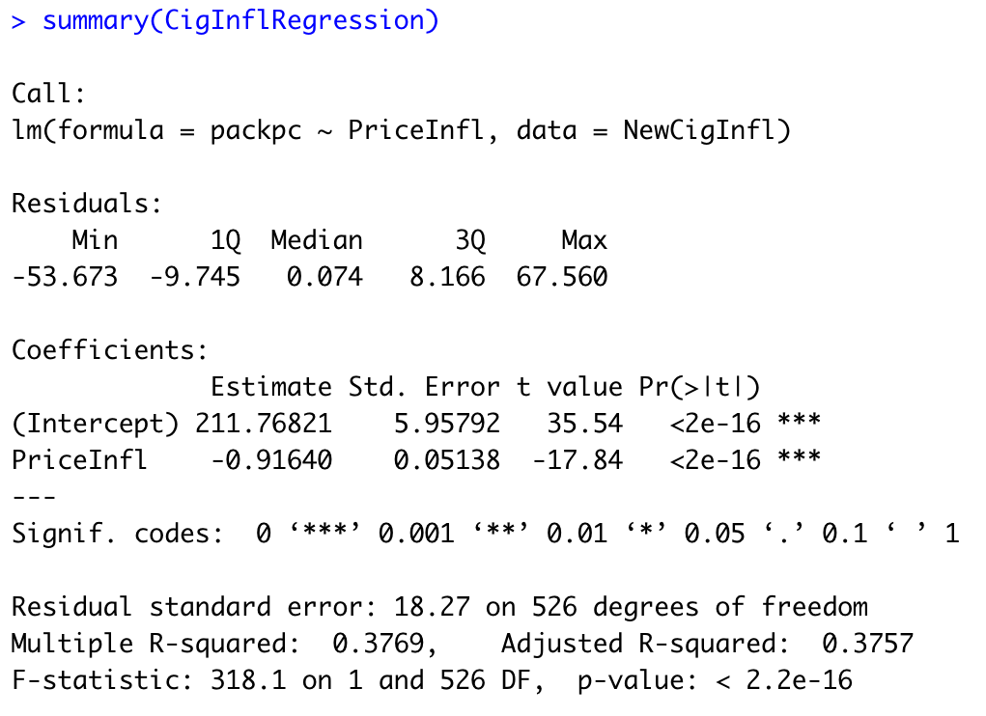
Linear regression: price adjusted for inflation
38% of the variability
The p-value <0.05, thus the price still shows a significant impact on the packs per capita. When comparing the two graphs, both have a negative correlation and both can be said that the higher the price is, the lesser packs per capita.
Note: inflation seems to have an effect on where the years lie on the graph of the Cigarette data set
CigInflRegression <- lm(packpc ~ PriceInfl, NewCigInfl)
summary(CigInflRegression)

Slide 11
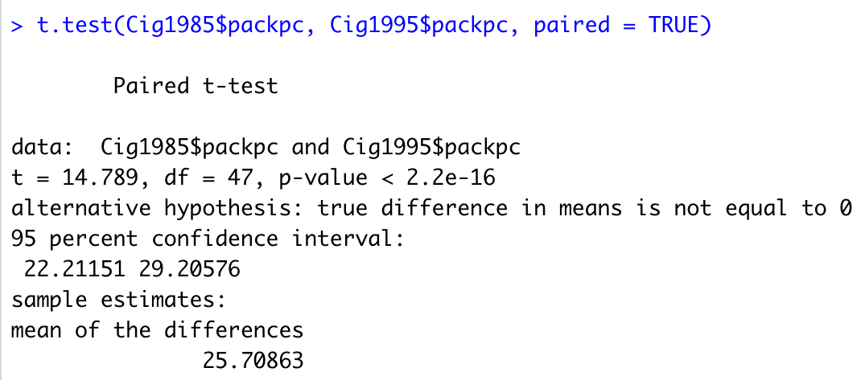
Paired t-test: difference between 1985 & 1995
p < .05; there is a significant difference between packs per capita in 1985 and packs per capita in 1995
Cig1985 <- Cigarette %>% filter(year == "1985")
Cig1995 <- Cigarette %>% filter(year == "1995")
t.test(Cig1985$packpc, Cig1995$packpc, paired = TRUE)

Slide 12
Curiosities from the cigarettes data set
When looking at the median packs per capita, what event happened to cause such a rapid decline from 1989 and onward?
Public health programs became a priority
A focus on protecting non-users from second-hand smoke was another factor that helped to usher in the decline of cigarette use in 1993
Smoking restrictions in public places, such as in restaurants and at work, became more prevalent

